Slide 1



Slide 2

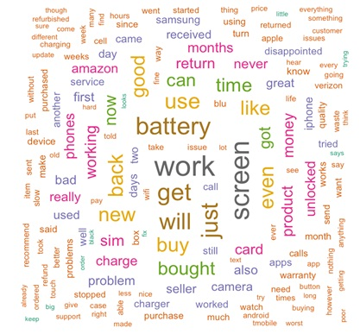

Analysis of amazon cell phone reviews using ibm cloud
PRESENTED BY:
TEAM N0:CSE-016

Slide 3

introduction
The smart phone market has been growing increasingly, not only in the conventional sales but has also been penetrating in the online shop. But not all smart phones have good quality to support the needs of consumers and it is to be noticed by the consumer. Before consumers decide to buy a smart phone, they should know the details of the specifications and functions of the smart phone, it can be learned from results of a review of smart phone users.
My project aims at building a model to predict the helpfulness of the review and the rating based on the review text. Corpus-based and knowledge-based methods can be used to determine the semantic similarity of review text. I used Natural language processing to analyse the sentiment (positive or a negative) of the given review
My project aims at building a model to predict the helpfulness of the review and the rating based on the review text. Corpus-based and knowledge-based methods can be used to determine the semantic similarity of review text. I used Natural language processing to analyse the sentiment (positive or a negative) of the given review

Slide 4

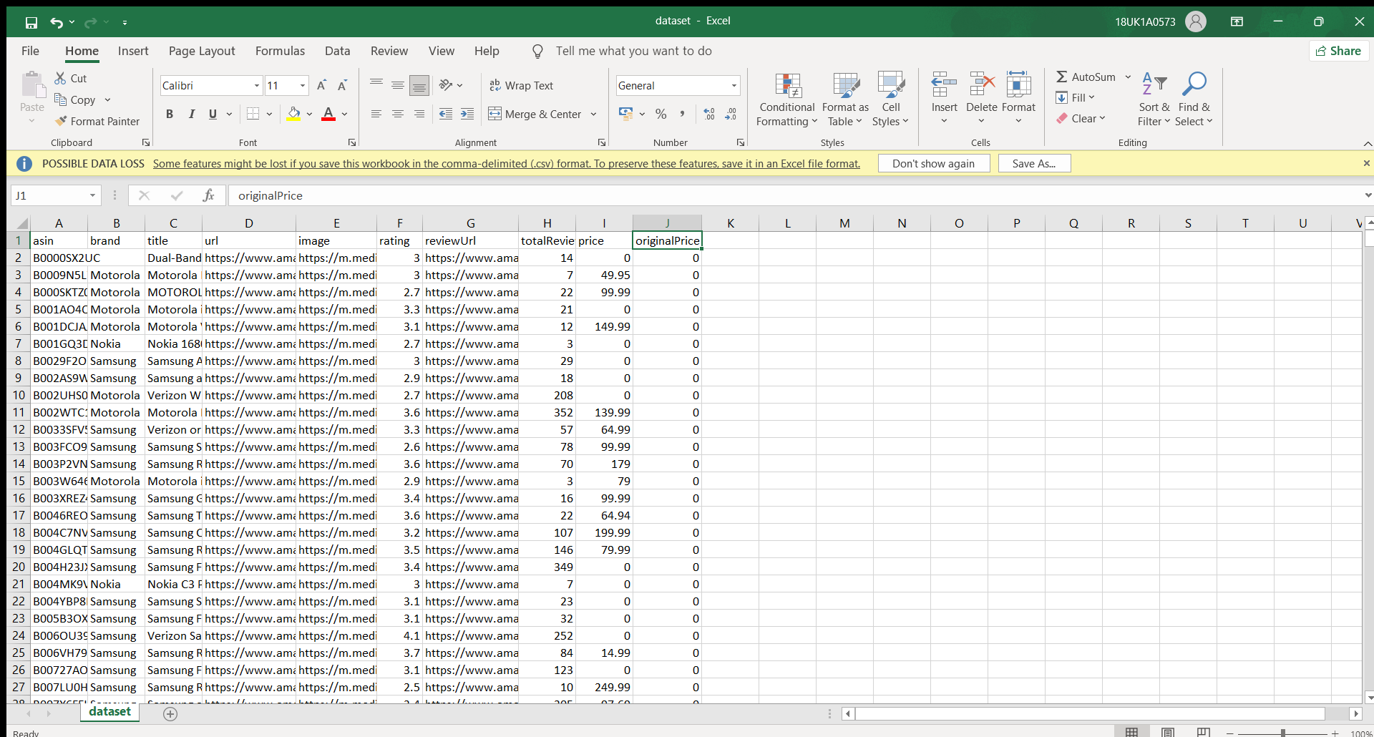



For this project ‘amazon cell phone reviews using IBM cloud, data is picked which is available on dataset websites
DATA SOURCE: INTERNET

Slide 5

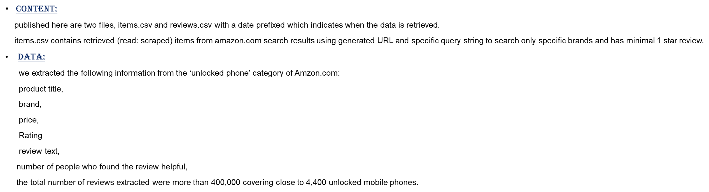

Slide 6

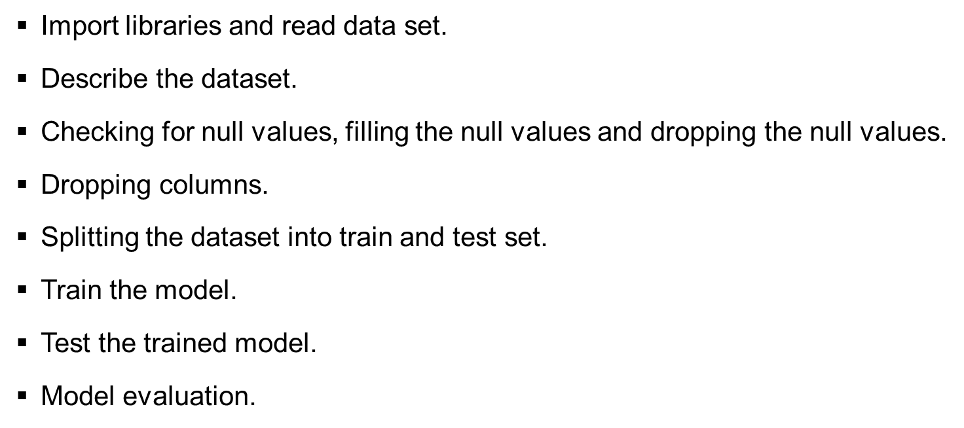

Slide 7
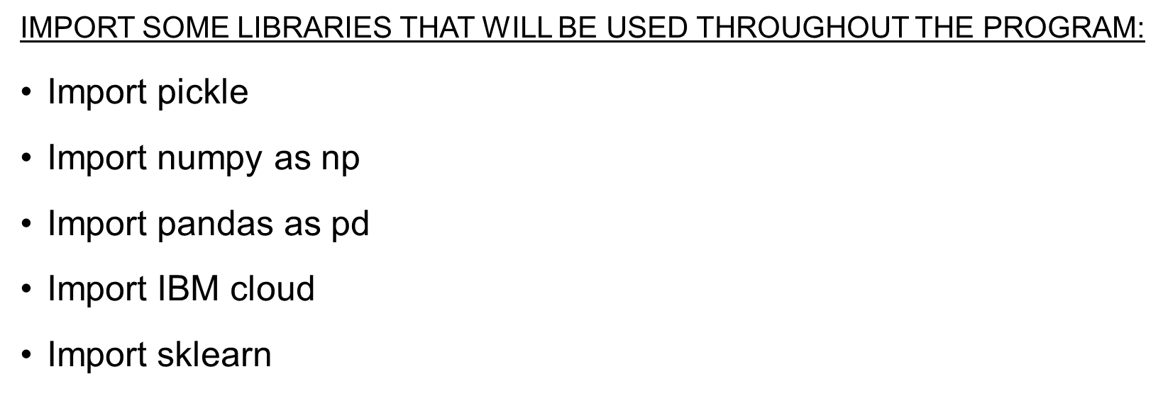

Slide 8

Here the data of numerical values were replaced by mean and categorical were replaced by median.
Data Cleaning and Future Selection:
Data cleaning is the process of fixing or removing incorrect, corrupted, incorrectly formatted, duplicate, or incomplete data within a dataset.
df.isnull().any()

Slide 9

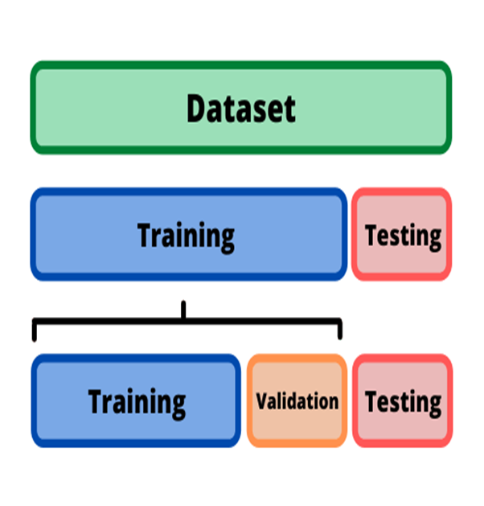
Split the dataset into train and test set:
Train/Test is a method to measure the accuracy of your model.
Training data sets are sets on which you train your machine i.e. algorithm to form relationships between variables.
Testing data set helps you to validate that the training has happened efficiently in terms of either accuracy, or precision so on

Slide 10
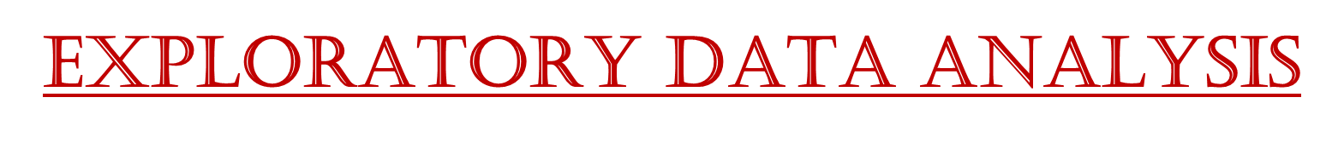

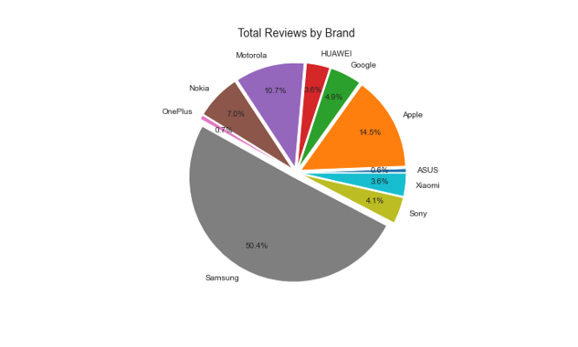
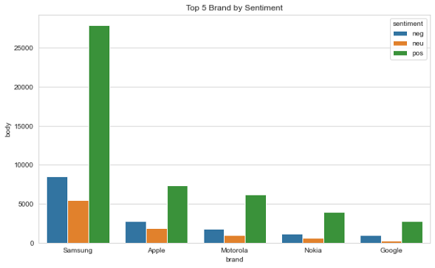
We have half data reviews dominated by Samsung brand (50,4%), I assume so many user in amazon website buying Samsung brand, because you can write a reviews when your account buying the product.
As we see on the graph Samsung brand have highest positive review than the competitor because they have a huge review on the amazon. Generally, we have average compound score 0.51 on negative review and 0.68 on positive review. Which means the model separated into good labelling for negative, neutral or positive reviews

Slide 11
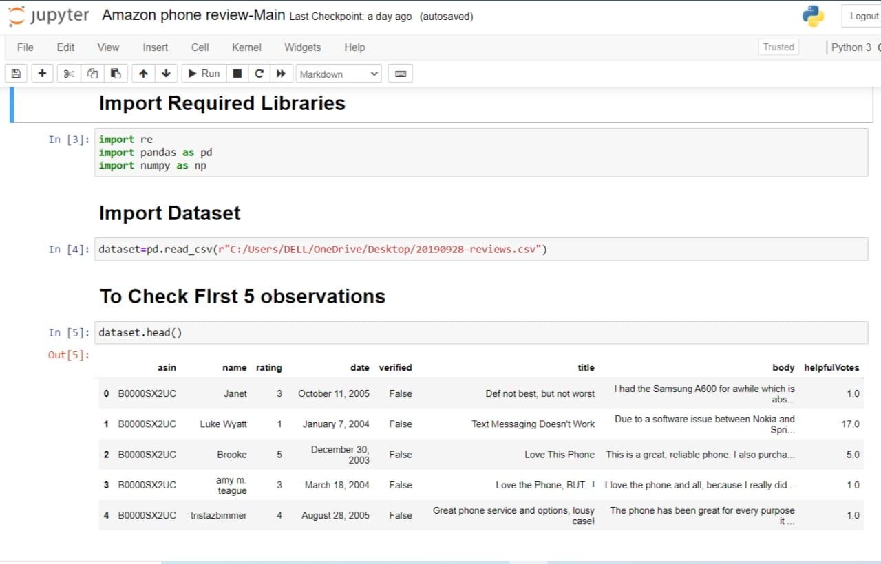
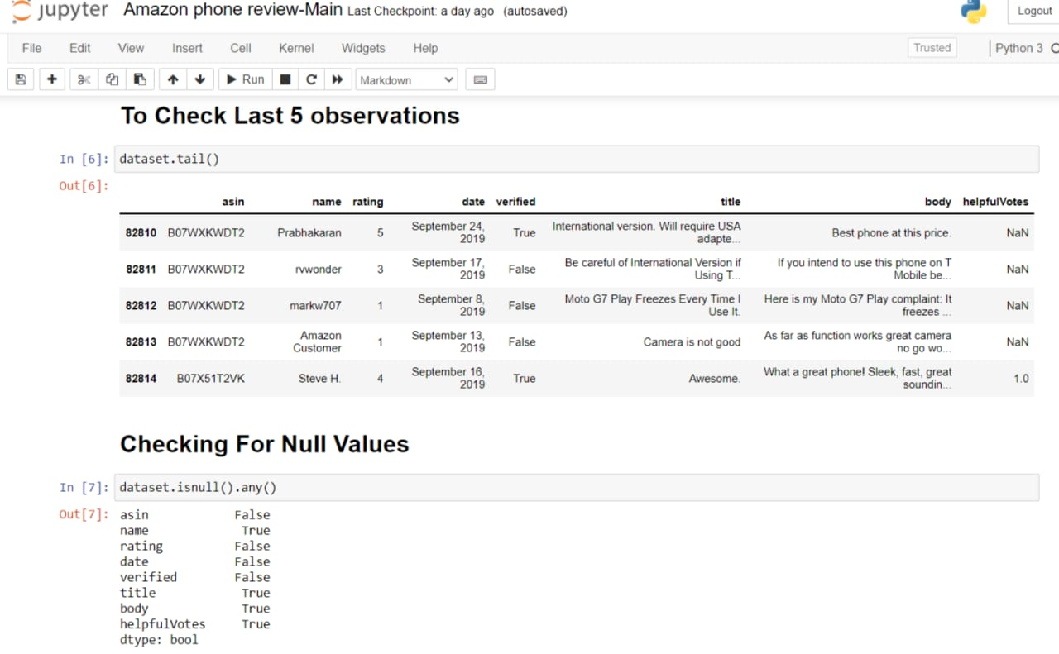

Slide 12
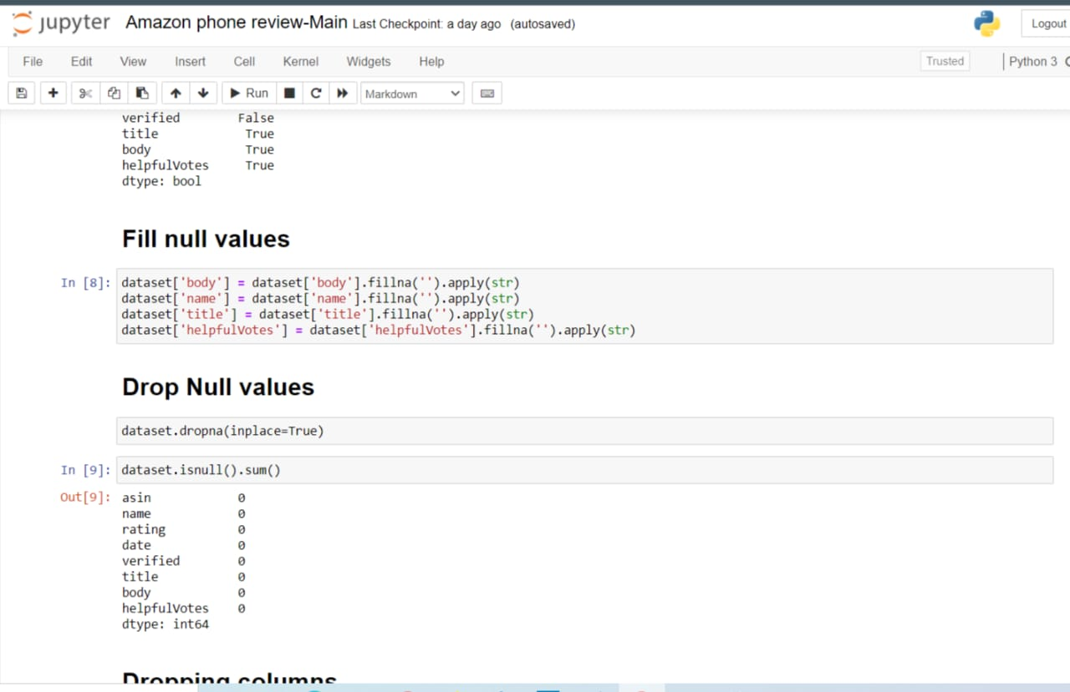
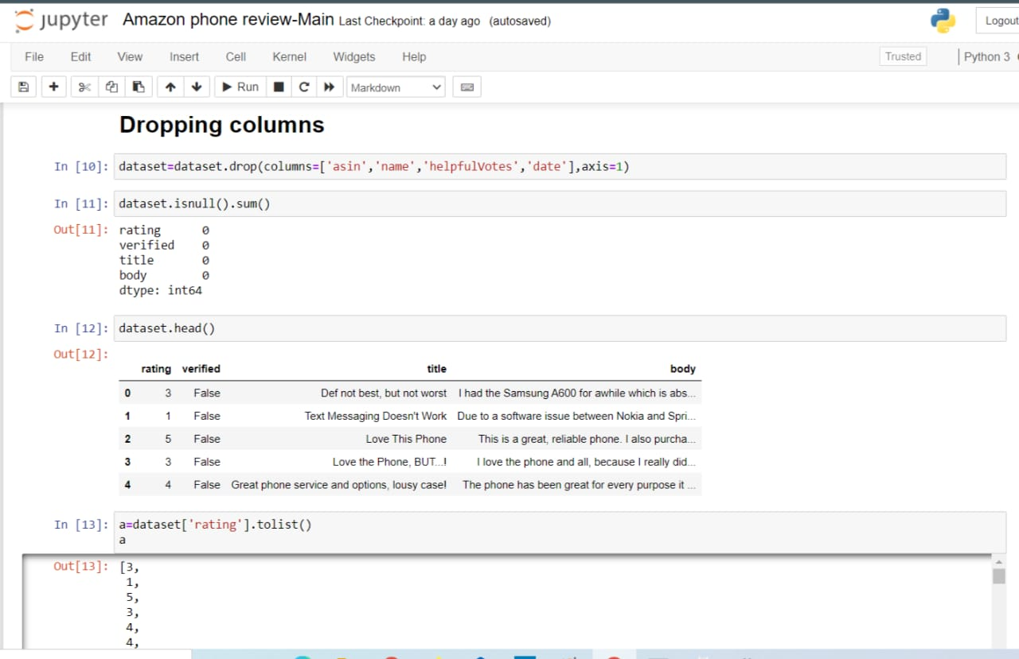

Slide 13
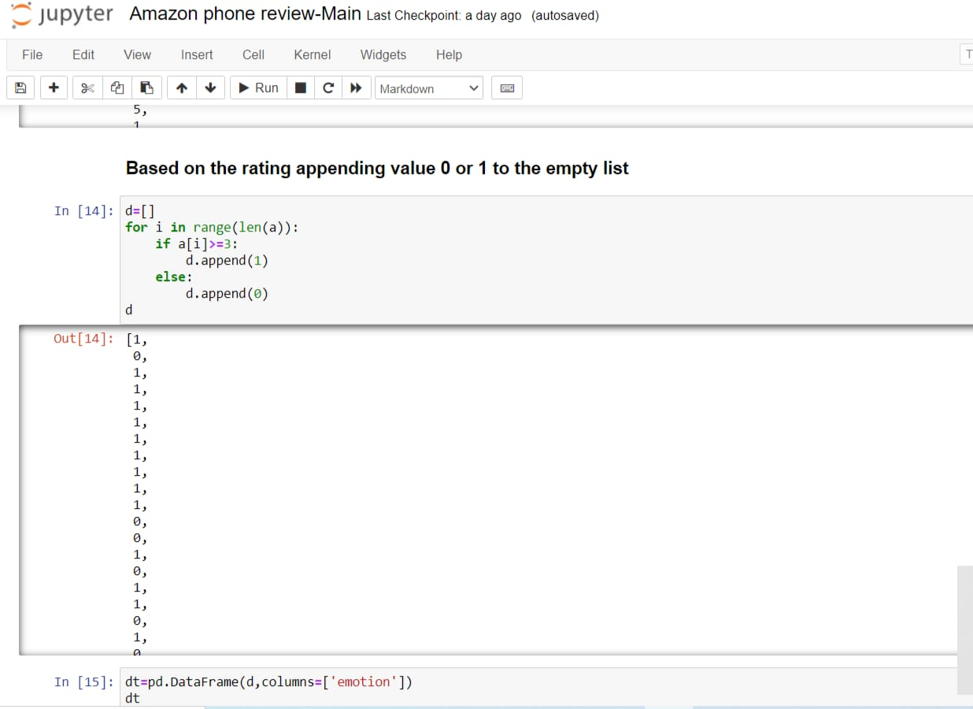
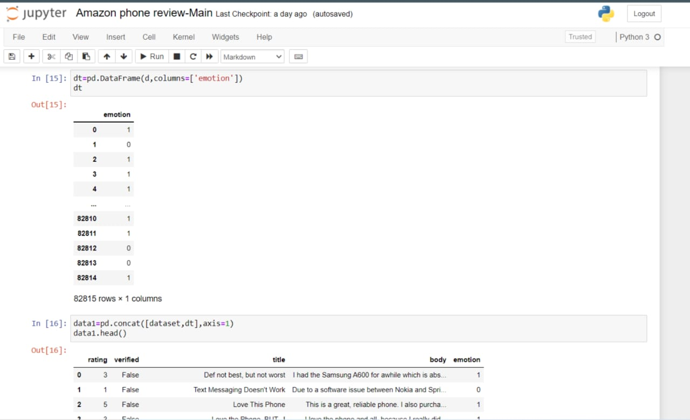

Slide 14
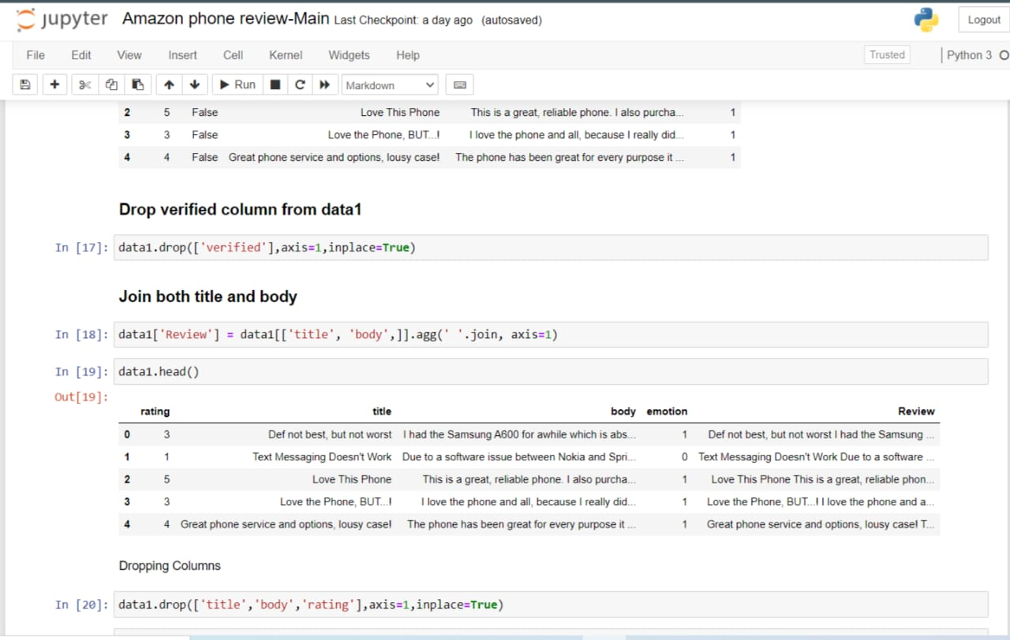
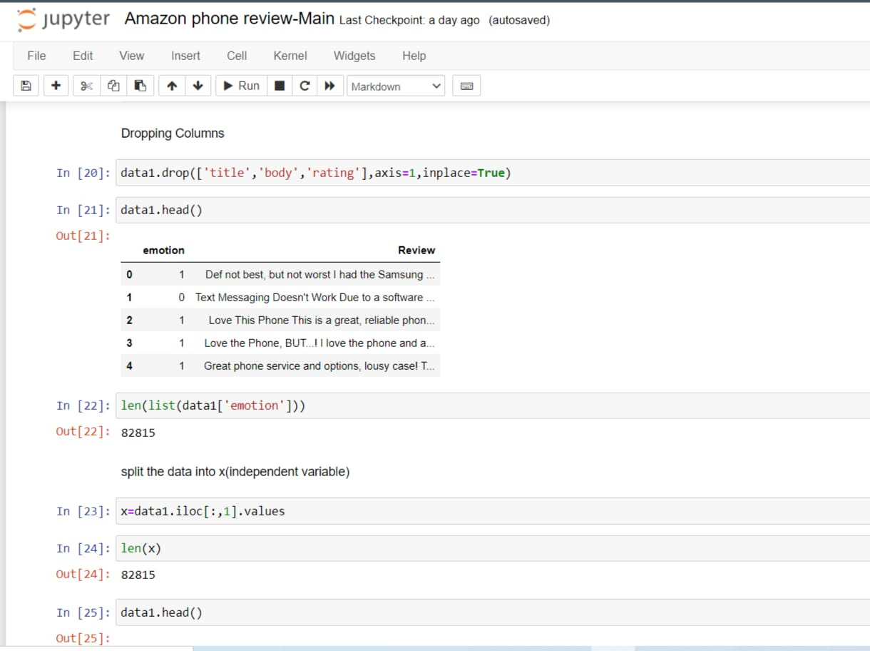

Slide 15
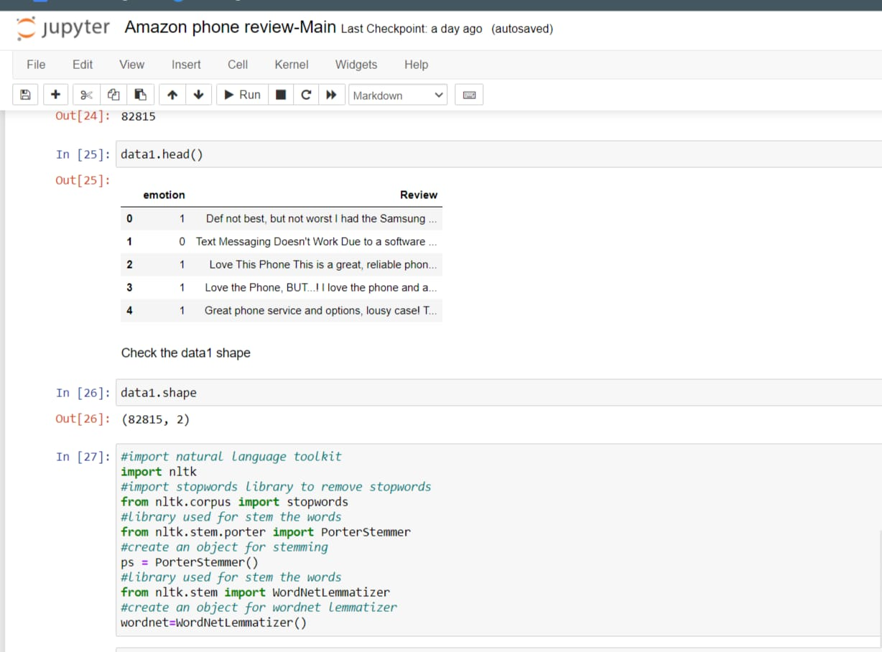
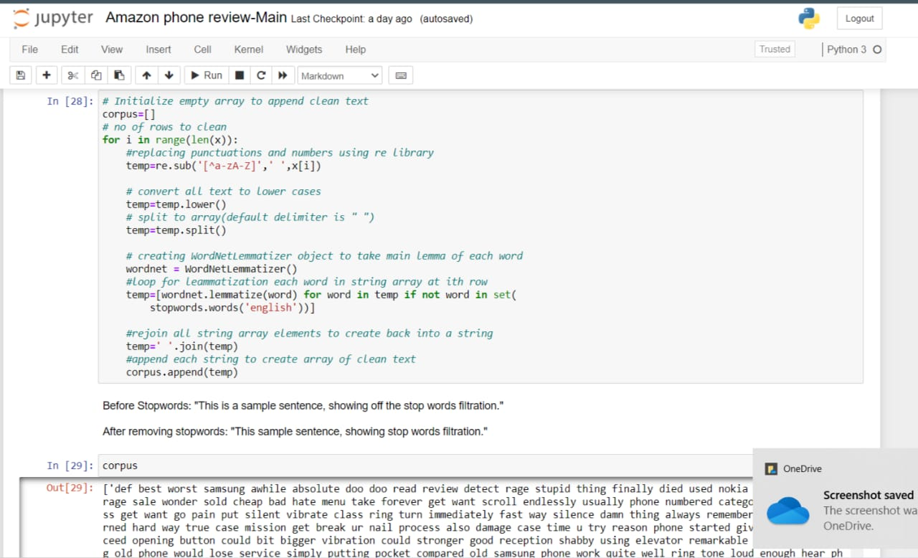

Slide 16
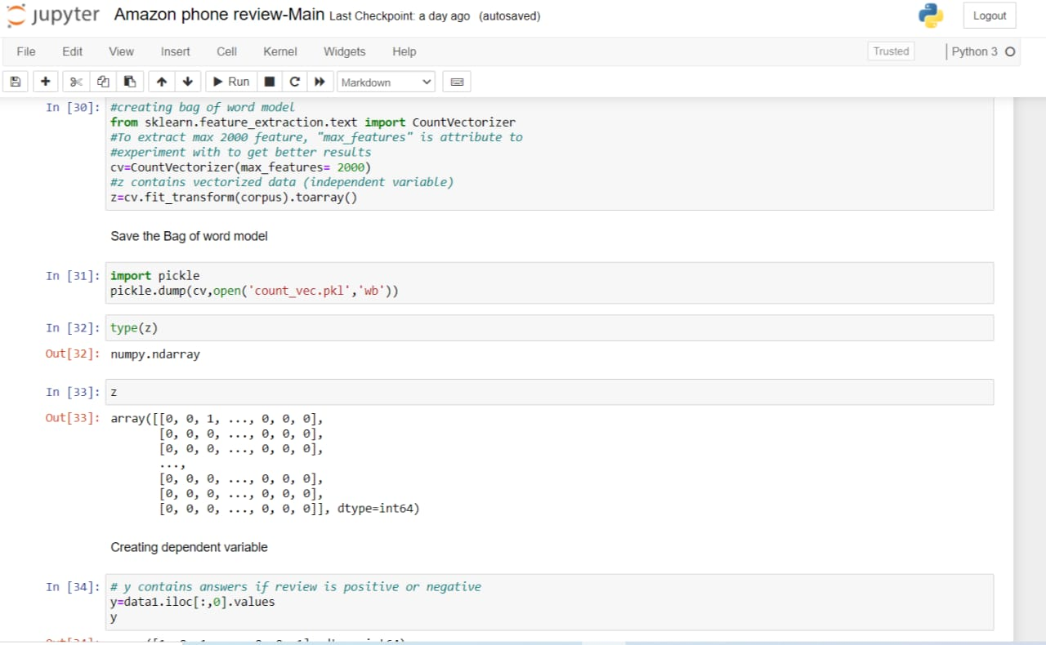
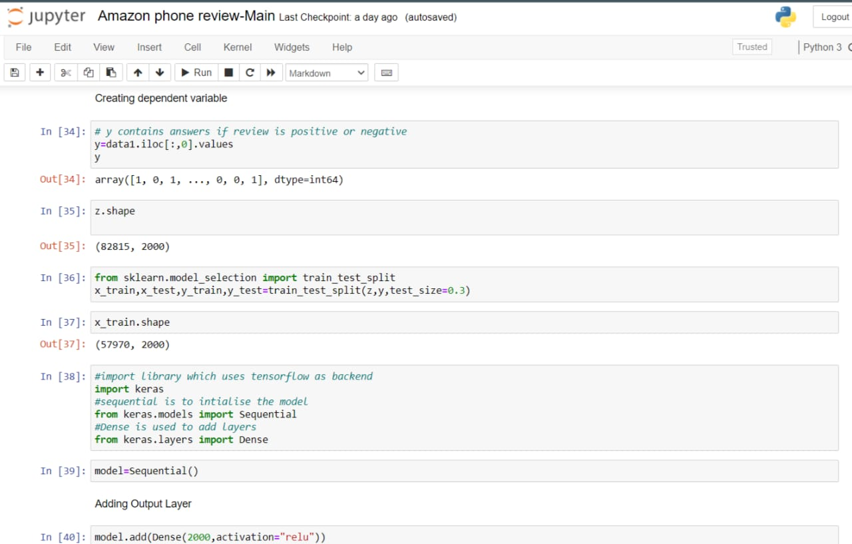

Slide 17
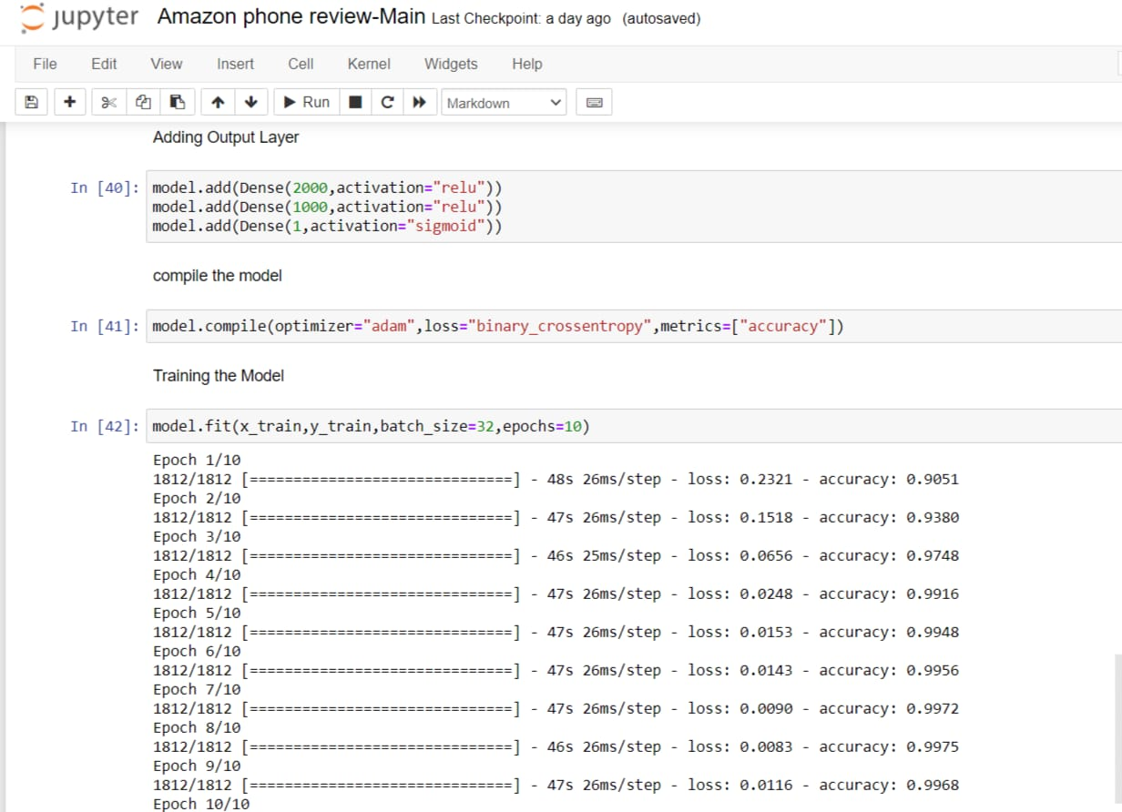
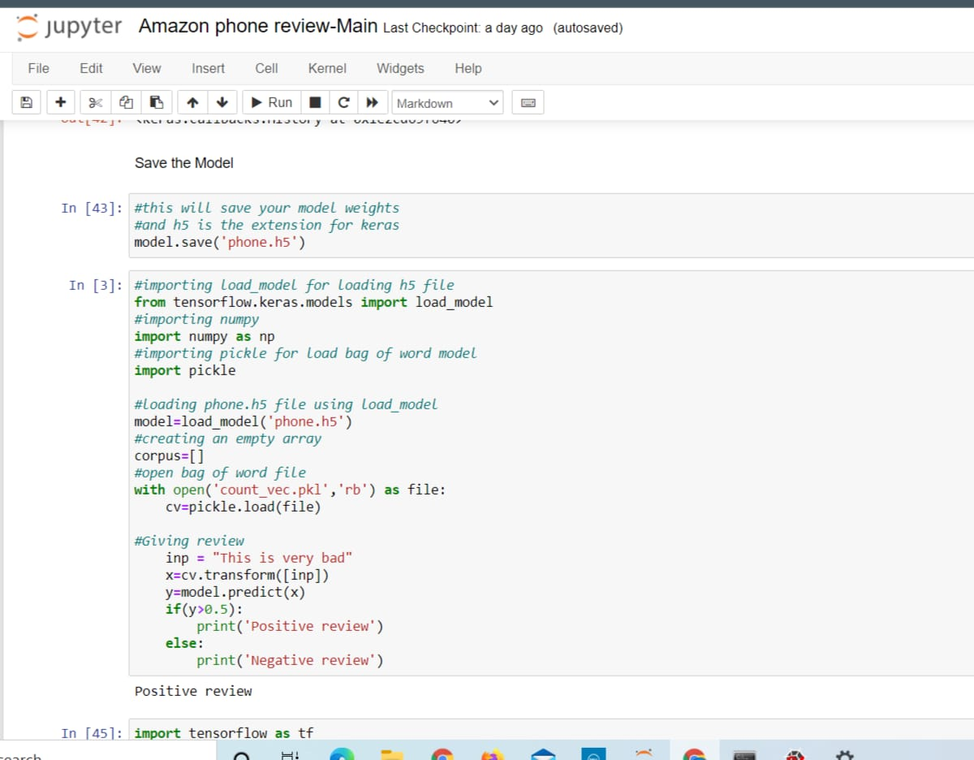

Slide 18
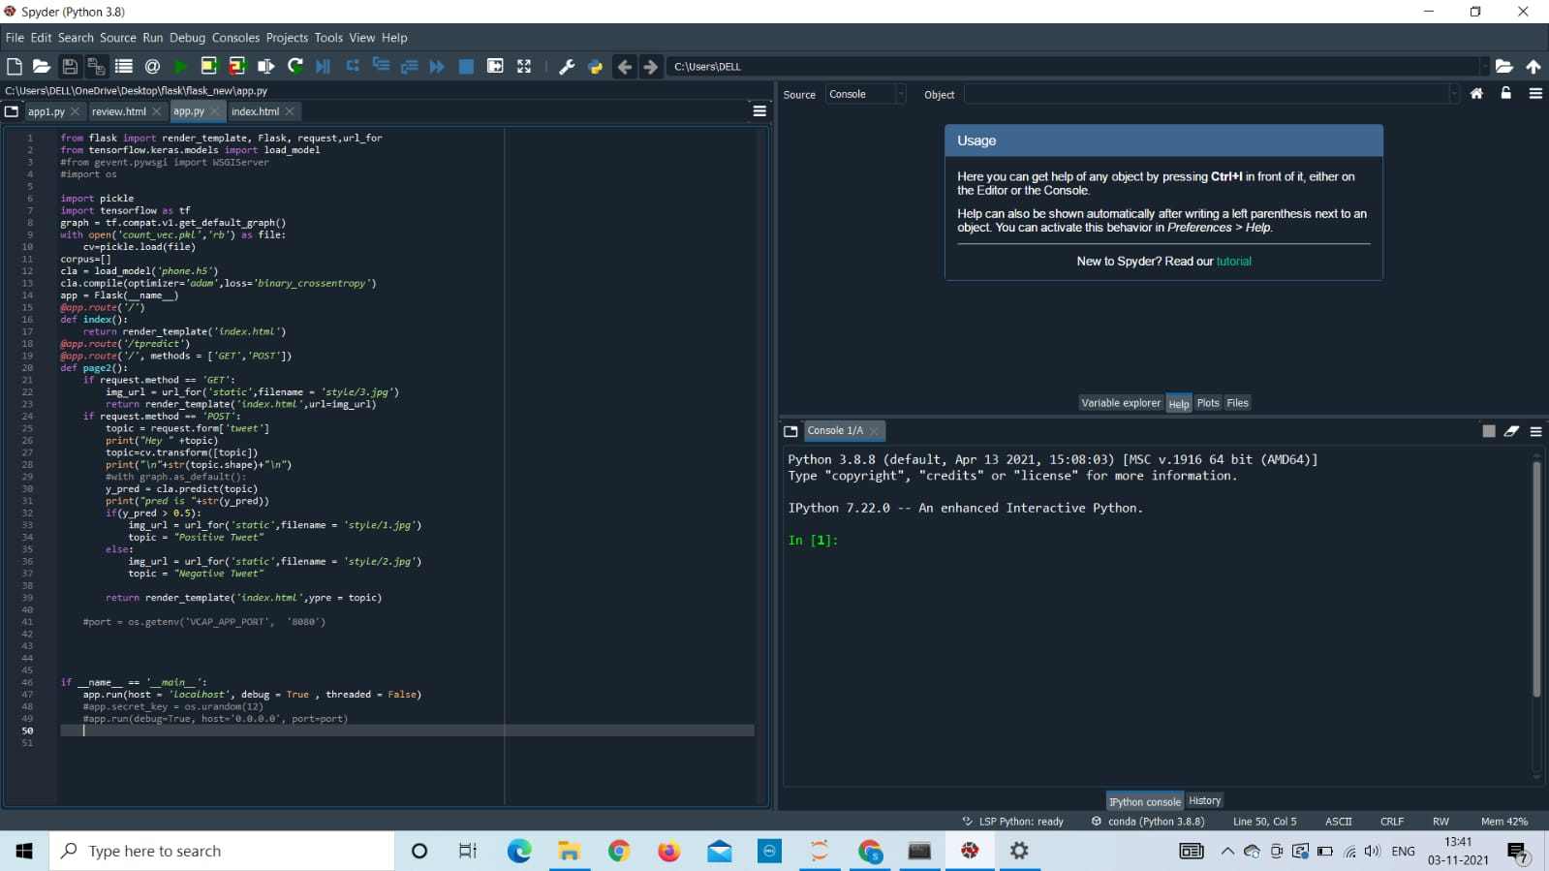

Slide 19
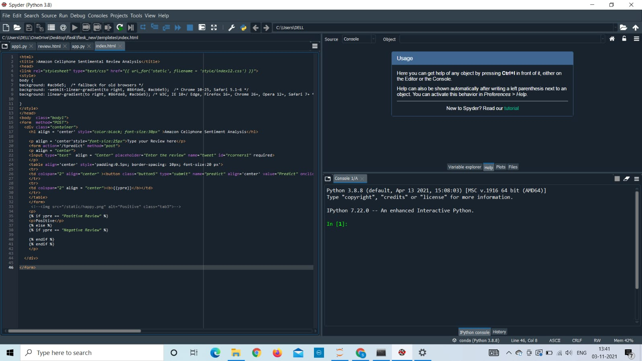

Slide 20
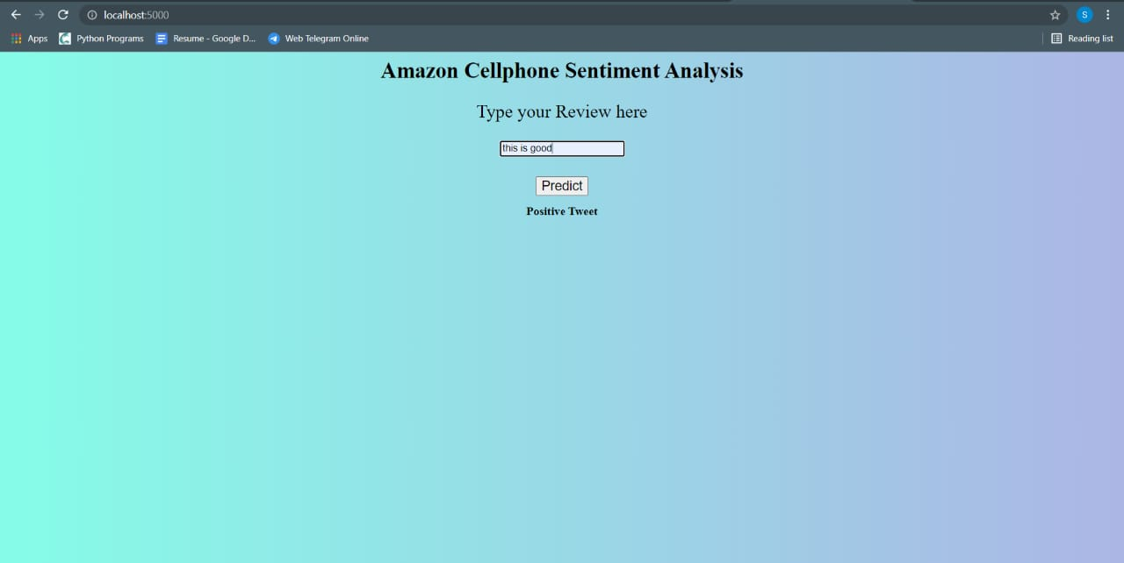
OUTPUT

Slide 21
Advantages: 1.By using sentiment analysis, you gauge how customers feel about different areas of your business without having to read thousands of customer comments at once. 2. Increases confidence in new customers and will save their time. 3.Brings credibility to products and the company. 4.Knowing which product works best.
Disadvantages:
1. One negative review of a product or business can skew a potential customer’s view of them
2.We need to keep reviews current and up to date. Otherwise they will seem out of date and irrelevant.
3.Disgruntled customers have the freedom to say whatever they like. This could lead to malicious or damaging information being posted.
4.Lack of touch or feel of products during online shopping is a drawback.

Slide 22

63% of customers are more likely to purchase from a site which has user reviews. Also to make them user friendly and easy for customers, my project analyses whether the review is a positive or a negative review and allows the customer to make good decisions.

Slide 23


